Slide 1
Pedestrian Detection and Localization
Members:
Đặng Trương Khánh Linh 0612743
Bùi Huỳnh Lam Bửu 0612733
Advisor:
A.Professor Lê Hoài Bắc
UNIVERSITY OF SCIENCE
ADVANCED PROGRAM IN COMPUTER SCIENCE
Year 2011

Slide 2
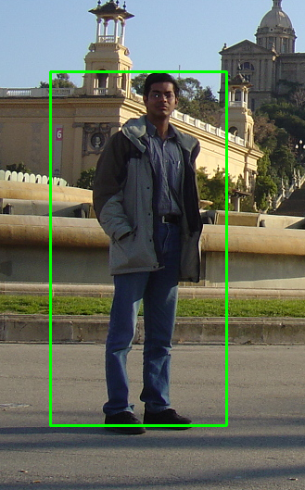
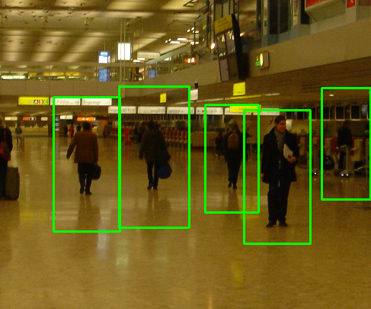
Problem statement
Build up a system which automatically detects and localizes pedestrians in static image.
Pedestrians: up-right and fully visible.

Slide 3
Applications
Automated Automobile Driver , or smart camera in general.
Build a software to categorize personal album images to proper catalogue.
Video tracking smart surveillance.
Action recognition.

Slide 4
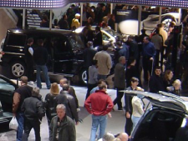
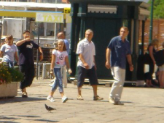
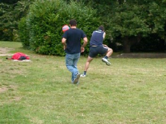
Challenges
Huge variation in intra-class.
Variable appearance and clothing.
Complex background.
Non-constraints illumination.
Occlusions, different scales.

Slide 5
Outline
Existing approaches.
Motivation.
Overview of methodology.
Learning phase
Detection
Our contributions:
Spatial selective approach
Multi-level based approach
Fusion Algorithm
Conclusions
Future work
Reference

Slide 6
Existing approaches
Haar wavelets + SVM: Papageorgiou & Poggio, 2000; Mohan et al 2000
Rectangular differential features + adaBoost: Viola & Jones, 2001
Model based methods: Felzenszwalb & Huttenlocher, 2000; Loffe & Forsyth, 1999
Lowe, 1999 (SIFT).
LBP, HOG, …

Slide 7
HOG

Slide 8
Motivation of choosing HOG
The blob structure based methods have fail to object detection problem.
Object detection methods via edge detection are unreliable.
Use the advantage of rigid shape of object.
Low complexity and fast running time.
Has a good performance.

Slide 9
Contributions
Re-implement HOG-based pedestrian detector.
Spatial Selective Method.
Multi-level Method.

Slide 10
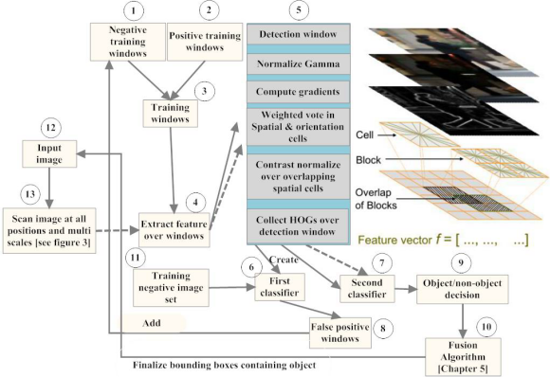
Overview of methodology

Slide 11
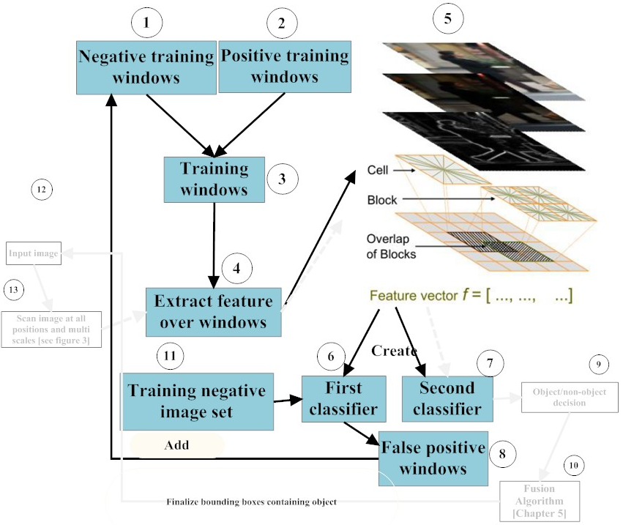
Learning Phase

Slide 12
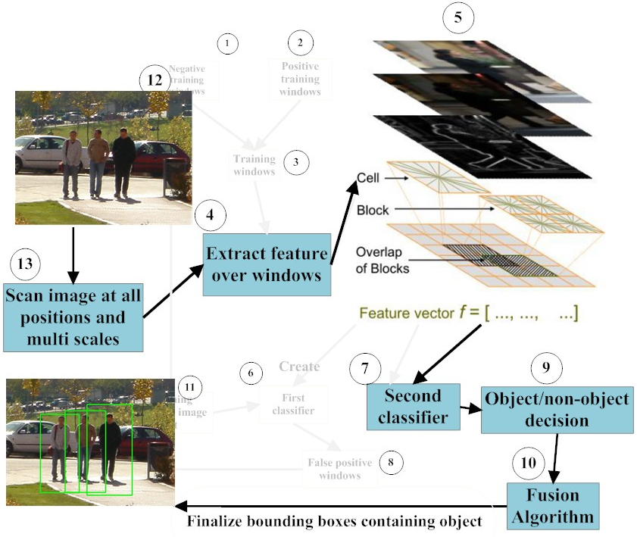
Detection Phase

Slide 13
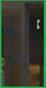
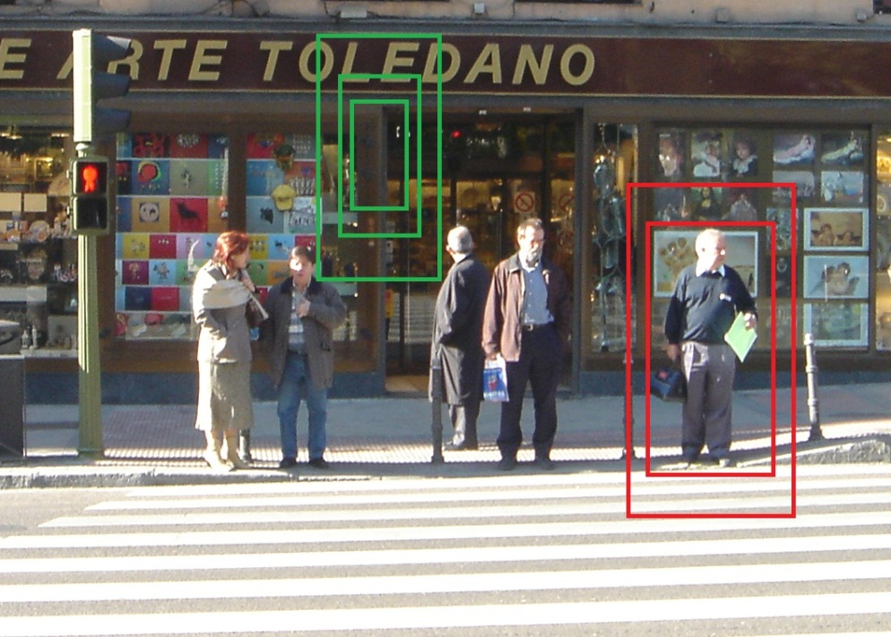
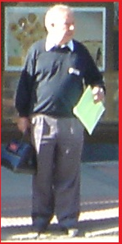
Scan image at all positions and scales
Object/Non-object classifier

Slide 14
Contributions
IMPROVEMENTS
PERFORMANCE
(Spatial Selective Approach)
ACCURACY
(Multi-Level Approach)

Slide 15
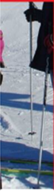
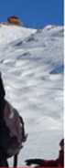
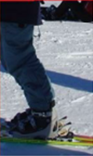
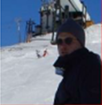
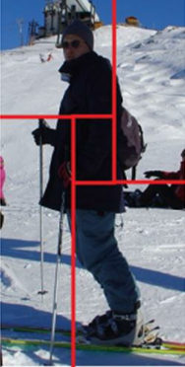
Spatial Selective Approach
Less informative region
Descriptor
[A1,..,Z1]
[A2,..,Z2]
[A3,..,Z3]
[A4,..,Z4]
[A1,..,Z1, A2,..,Z2, A3,..,Z3, A4,..,Z4]

Slide 16
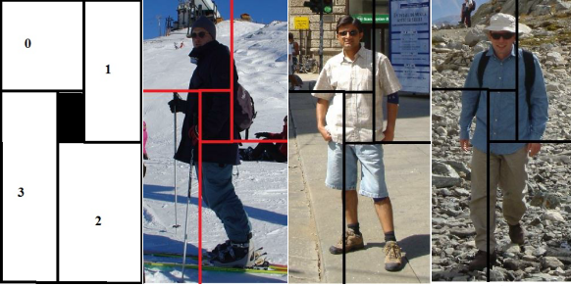
Spatial Selective Approach
Examples:

Slide 17
Multi-level Approach
Purpose: enhance the performance by getting more information about shape and contour of object.
Diff distance

Slide 18

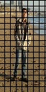
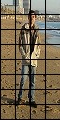
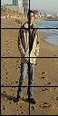
Multi-level Approach
HOG
[A1,..,Z1]
[A2,..,Z2]
[A3,..,Z3]
[A1,..,Z1, A2,..,Z2, A3,..,Z3, A4,..,Z4]

Slide 19
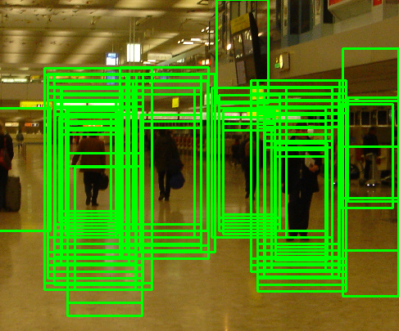
Fusion Algorithm

Slide 20
Mean shift
Region of
interest
Center of
mass
Mean Shift
vector
Slide by Y. Ukrainitz & B. Sarel

Slide 21
Mean shift
Region of
interest
Center of
mass
Mean Shift
vector
Slide by Y. Ukrainitz & B. Sarel

Slide 22
Mean shift
Region of
interest
Center of
mass
Mean Shift
vector
Slide by Y. Ukrainitz & B. Sarel

Slide 23
Mean shift
Region of
interest
Center of
mass
Mean Shift
vector
Slide by Y. Ukrainitz & B. Sarel

Slide 24
Mean shift
Region of
interest
Center of
mass
Mean Shift
vector
Slide by Y. Ukrainitz & B. Sarel

Slide 25
Mean shift
Region of
interest
Center of
mass
Mean Shift
vector
Slide by Y. Ukrainitz & B. Sarel

Slide 26
Mean shift
Region of
interest
Center of
mass
Slide by Y. Ukrainitz & B. Sarel

Slide 27
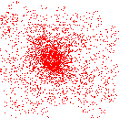
Mean shift clustering
Cluster: all data points in the attraction basin of a mode
Attraction basin: the region for which all trajectories lead to the same mode
Slide by Y. Ukrainitz & B. Sarel

Slide 28
Non-maximum suppression
Using non-maximum suppression such as mean shift to find the modes.

Slide 29
Experiments
Re-implement Dalal‘s Method
Spatial Selective Method
Multi-Level Method

Slide 30
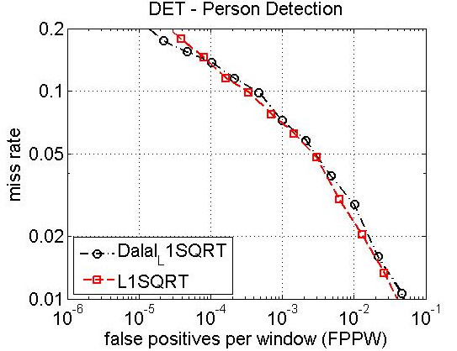
Result of re-implementation

Slide 31
Examples

Slide 32
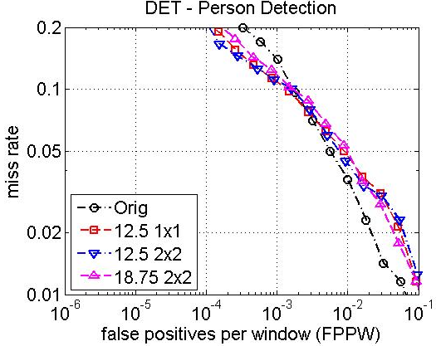
Result Spatial Selective Method

Slide 33
Vector Length v.s Speed
A:B → Deleted cell(s): Overlap cell(s)

Slide 34
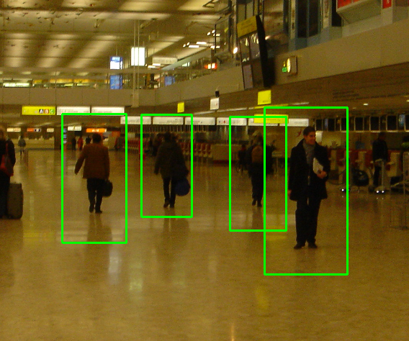

Examples
Original
Re-implement

Slide 35
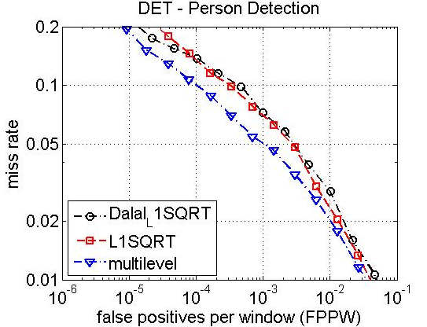
Result Multi-Level

Slide 36
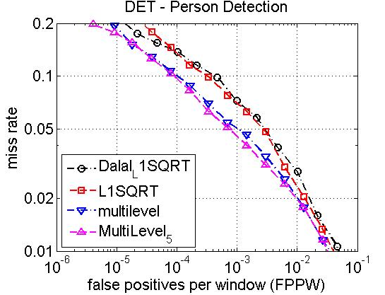
Result(cont…)

Slide 37
Feature vector length v.s time

Slide 38
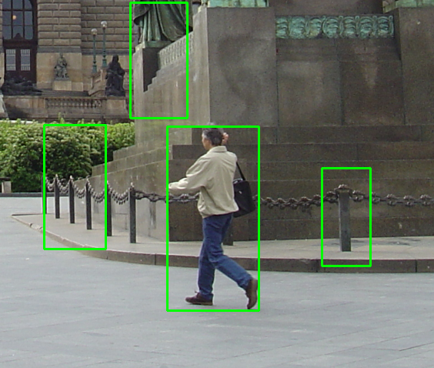
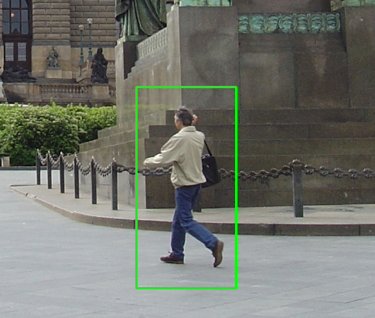
Examples
Original
Multi-level

Slide 39
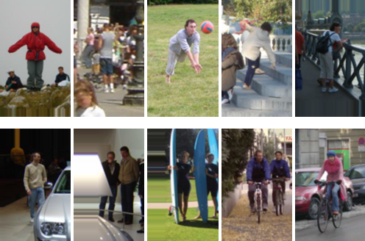
Dataset
INRIA pedestrian dataset
Train: 1208 positive windows 1218 negative images
Test: 566 positive windows 453 negative images

Slide 40
Conclusions
Successfully re-implement HOG descriptor.
Propose the Spatial Selective Approach which take advantages of less informative center region of image window.
Multi-level has more information about shape and contour of object.

Slide 41
Future work
Non-uniform grid of points.
Combination of Spatial Selective and Multi-level approach.

Slide 42
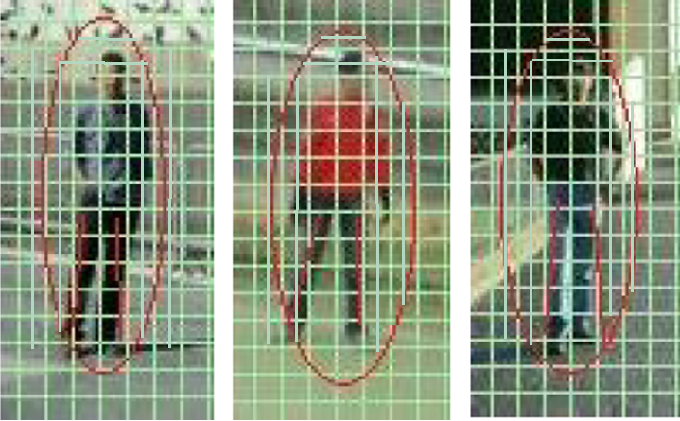
Non-uniform grid of points

Slide 43
References
N. Dalal and B. Triggs, “Histograms of oriented gradients for human detection,” in IEEE Conference on Computer Vision and Pattern Recognition, 2005.
Subhransu Maji et al. Classification using Intersection Kernel Support Vector Machines is Efficient. IEEE Computer Vision and Pattern Recognition 2008
C. Harris and M. Stephens. A combined corner and edge detector. In Alvey Vision Conference, pages 147–151, 1988.
D. G. Lowe. Distinctive image features from scale-invariant keypoints. International Journal of Computer Vision, 60(2):91–110, 2004.

